Slide 1
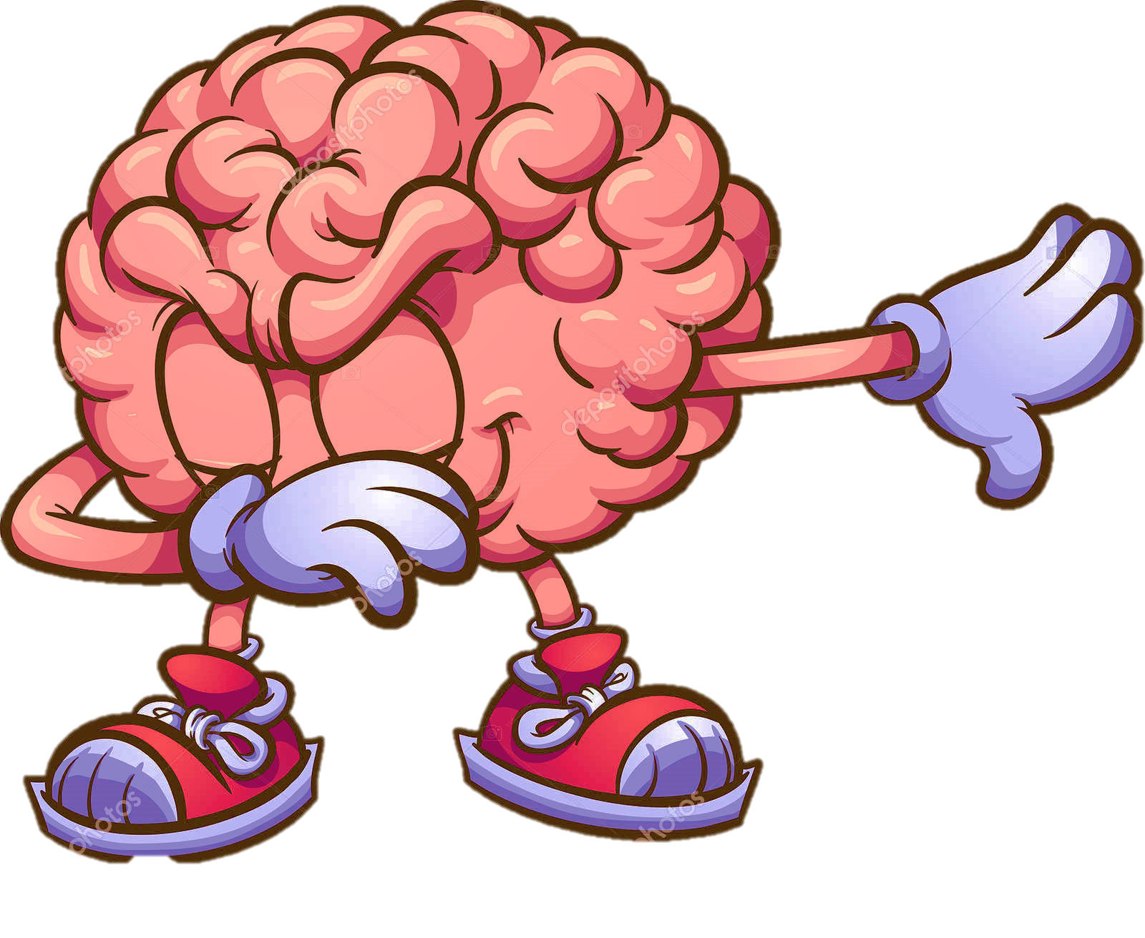
BRAIN-O-BRAIN
QUIZ GAME
COME LET’S PLAY

Slide 2
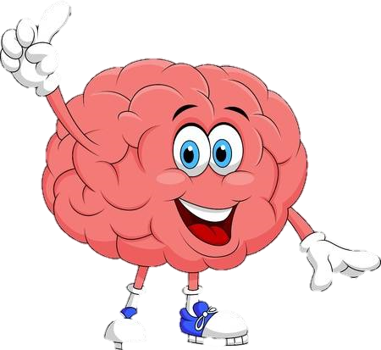
INTRODUCTION
“LIFE IS A GAME –PLAY IT
LIFE IS A CHALLENGE MEET IT”
As the quotation suggest our mini project is all about a quiz game-”BRAIN-O-BRAIN.
Quiz is the form of game or mind sport in which player attempt to answer , question correctly. It is generally a frequent and short assessment that can gauge a students retention and comprehension of small amount of information.
In this era of science and technology when everyone is so busy that they don’t even have time for themselves , for maintaining their health and routine. So for maintaining their balance between the stressful schedules and peaceful mind , they use several modes of entertainment , meditation and exercise . online gaming is one of the fastest growing trend in today’s generation.
Today internet is an open place where you can access a vast amount of information. Online gaming makes the player sharper and mentally more active. The game generally have various levels or missions to be completed in limited time. this helps the player in learning about time management.
One of the main and important advantage of playing online game is to learn mind and hand coordination. He learns to coordinate mind with the actions of hand. while executing those actions, they also develop mental strength.

Slide 3
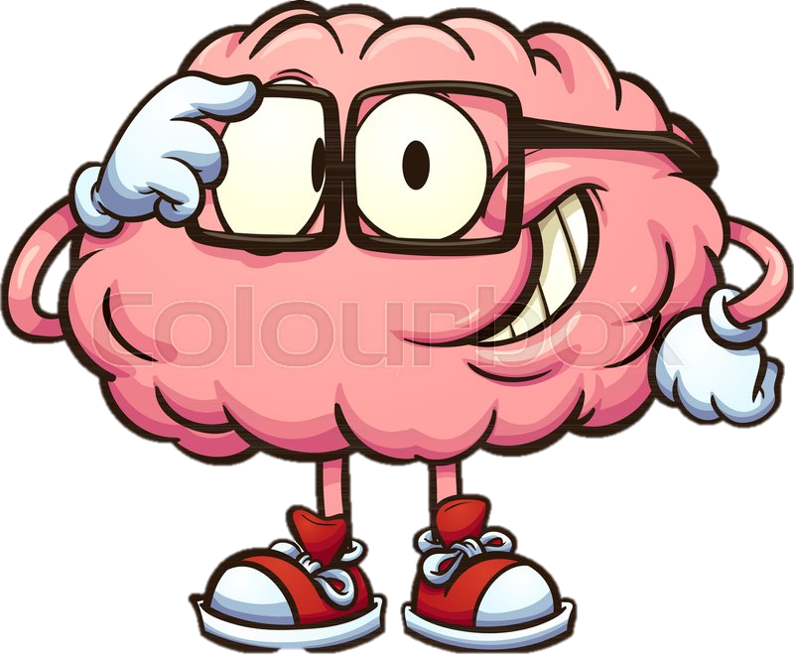
TYPES OF QUIZZES
Multiple Choice. Multiple choice questions are among the most effective ways to test learners on the content of the e-course.
Yes or No.
Open-Ended
Fill in the Blank
Matching.
Definitions.

Slide 4
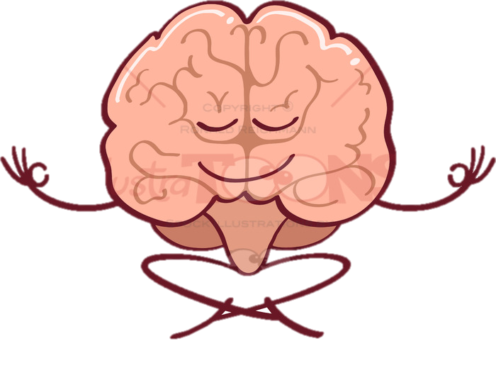
The first section deals with the description of quiz game and it’s application in different sectors, and it’s future scope of this technology .
The nest section deals with the modules of the project means the functions include , library used , list , dictionary and strings etc.
Later part of the presentation covers the process of playing quiz and the code for the software and it’s working.
The other part also provide us with some of the snapshots which shows how this game can be played or how it woks .
Finally presentation concludes at the different potentials uses of the application of BRAIN-O-BRAIN and it’s further improvement and considerations.

Slide 5
Technology used
SOFTWARE :--
IDLE 3.0 – idle has two main window types -- the shell window and the editor window.it is possible to have the multiple editor windows simultaneously. On windows and Linux , each has its own top menu . each menu documented below indicates which window type it is associated with.
Sublime text – sublime test is a proprietary cross- platform source code editor with a python application programming interface. It is supports many programming languages and mark-up languages. Compatible with many language grammars.
Notepad- notepad is a simple text editor for Microsoft windows and a basic text- editing program which enables computer users to create documents. The resulting files typically saved with .txt extension, have no format tags and style, making the program suitable for editing system files, source code for later compilation or execution, usually through a command prompt.
GUI- the graphical user interface is a form of user interface that allows users to interact with electronic devices through graphical icons and visual indicators such as secondary notations, instead of text based user interfaces, typed command labels or text navigation.
Python offers multiple options for developing GUI. Out of all the GUI methods TKINTER is most commonly used method. It is a standard python interface to the TK GUI tool kit shipped with python. Python with TKINTER outputs the fastest and easiest way to create GUI applications.

Slide 6
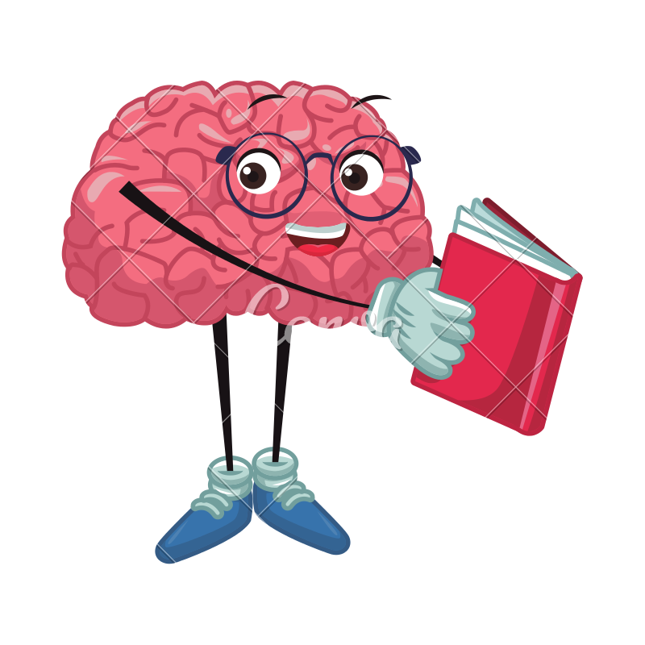
Language used:-
Python- python is an interpreted, high level, general purpose programming language. Created by Guido van Rossum and first release in1991, python design philosophy emphasises code readability with its notable use of significant whitespace. Its language constructs and object-oriented approach aim to help programmers write clear, logical code for small and large- scale projects.
It supports multiple programming paradigms and functional programming. Python is often describe as a “batteries included” language due to its comprehensive standard libraries. Python was conceived in the late 1980’s as a successor to the ABC language. Python 2.0, released 2000, introduced features like list comprehension and a garbage collection system capable of collecting reference cycles.
Python 3.0 released in 2008, python 2, python 3, python 2.7 and python 3.6 are the versions of python released till date.
Latest version of python being used today is python 3.8.0.

Slide 7
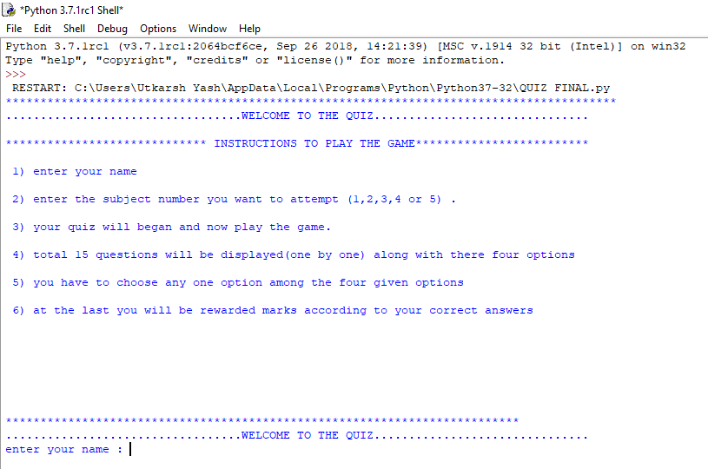
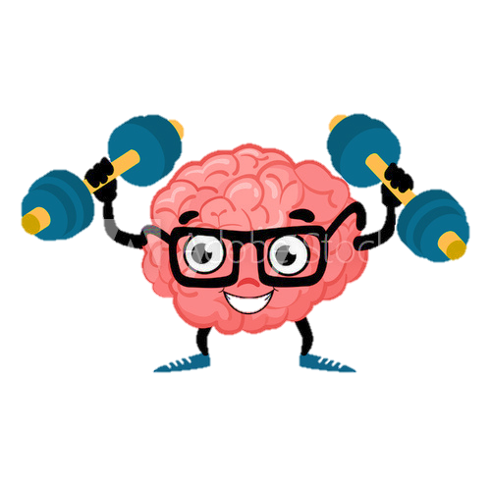
MODULE COVERED
The project starts with the welcome screen which display the common instruction to play the game.
It also show or display a set guideline to familiarise the player with the game all this is written or coded in introduction() function.
In introduction() function we have used for loop and print statements to display the desired screen.

Slide 8
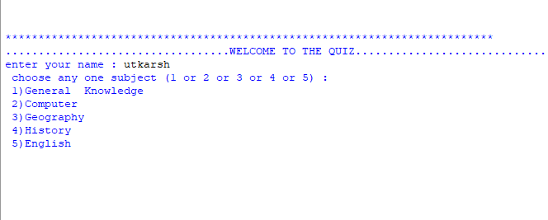
The next screen appears which again shows the welcome message and it ask the player to enter some personal details like:
Enter your name.
now you will be shown a list of subjects and you have to choose the number of any one subject .
We had done all this using welcome() function in which we had used for loops, print statement, if-else loops and exit to form desired screen.

Slide 9
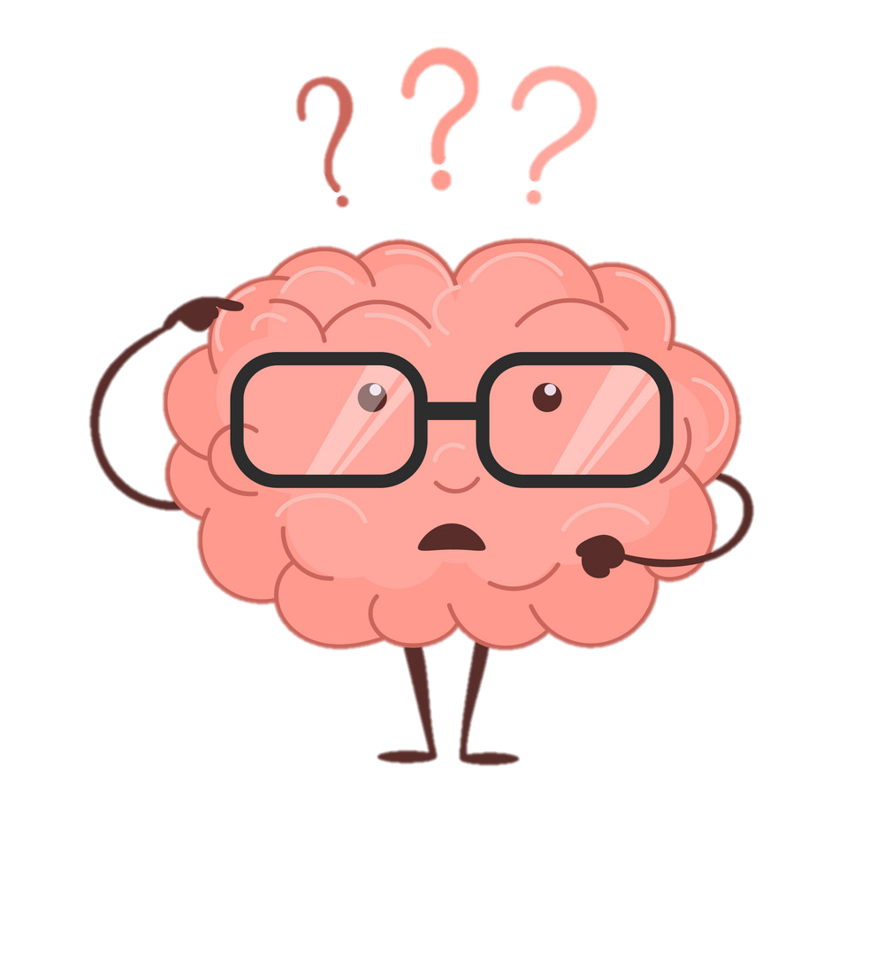
The very next screen is main screen which presents the quiz questions and options . there are five cases – general knowledge , history , geography ,English and computer. If you will select general knowledge then the below given screen will appear .
It shows one questions and its four options and then similarly next question will be displayed and so on.
Total 15 questions will be displayed in similar manner.
After selecting the right option you will be awarded marks as per the right answer.
We have used five list to store:
q[]-To store all questions.
opta[]-To store option(a) of all the questions.
optb[]-To store option(b) of all the questions.
optc[]-To store option(c) of all the questions.
optd[]-To store option(d) of all the questions.
And finally a list keys to stores the right options of al the questions.
Finally, we calculate score and display it.
And similar procedure will be performed in other subjects also .

Slide 10
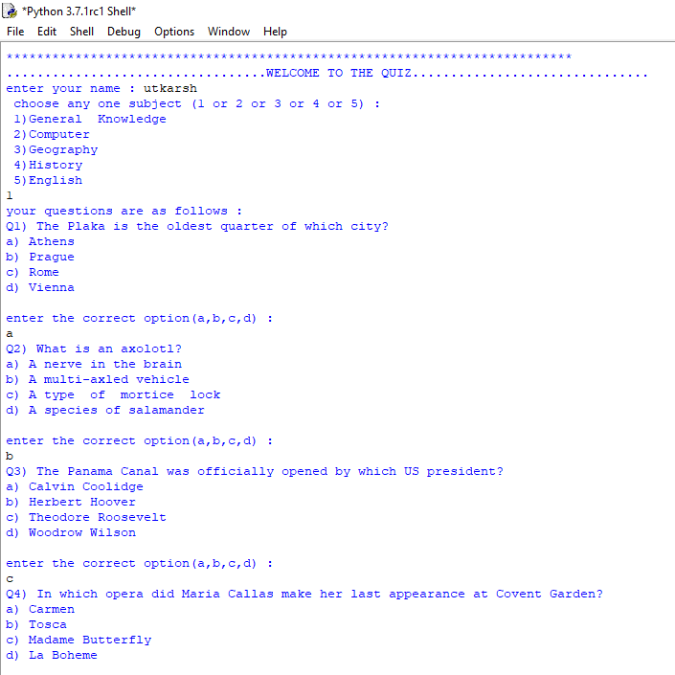

Slide 11
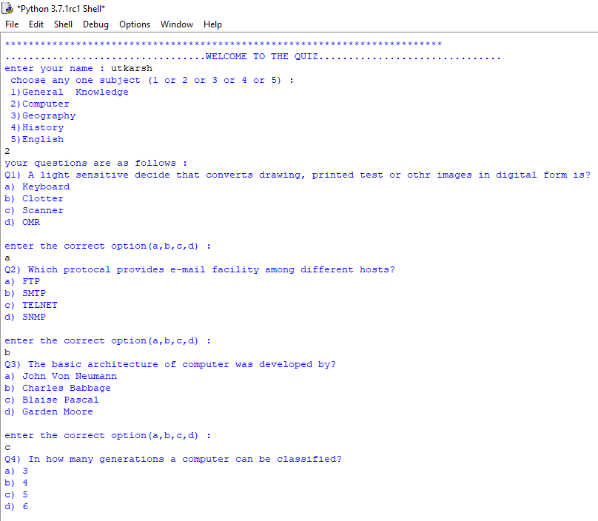

Slide 12
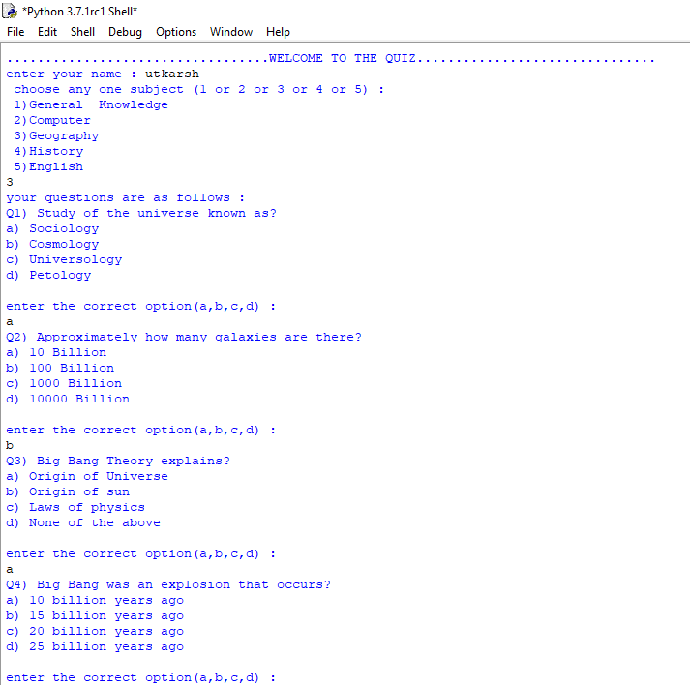

Slide 13
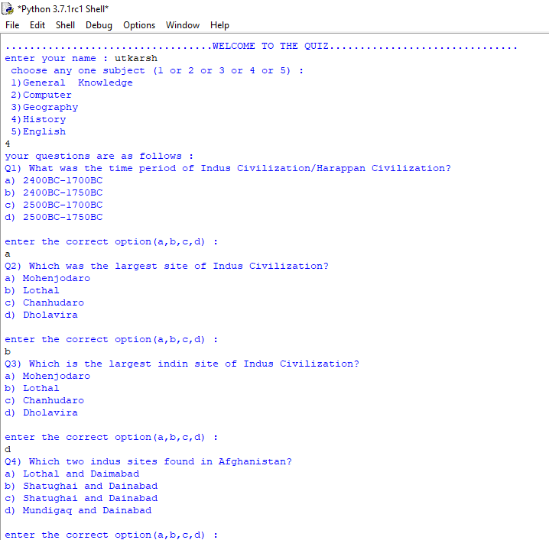

Slide 14
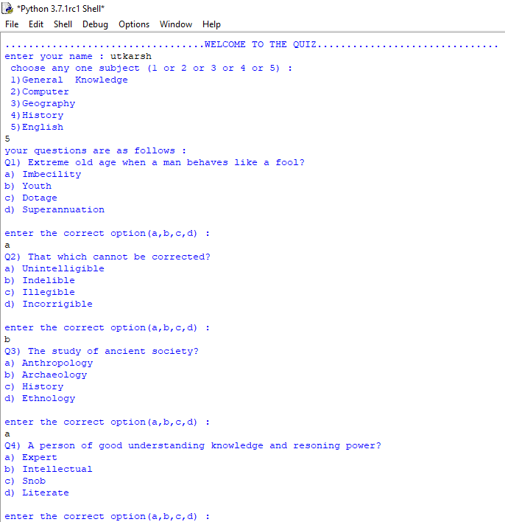

Slide 15
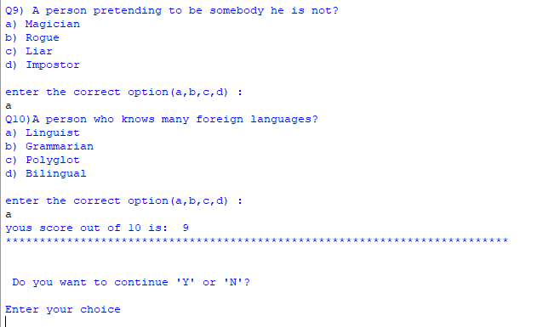
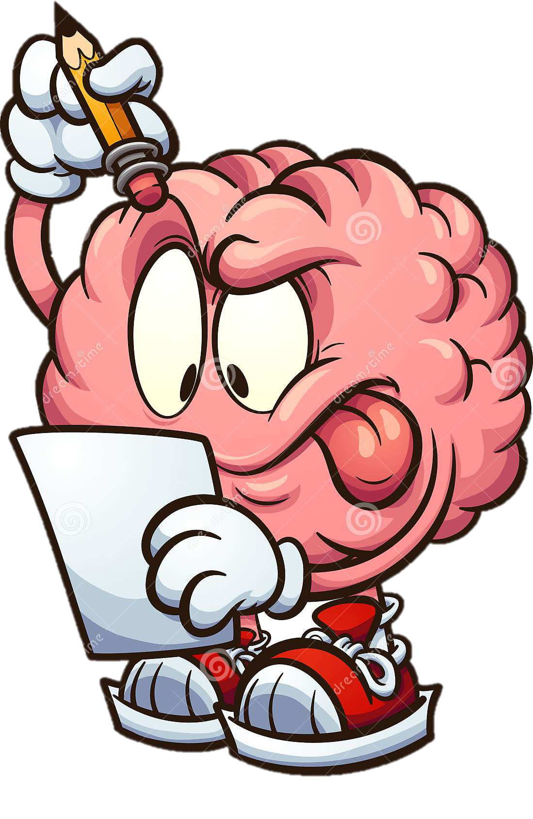
Below given snapshot shows how the marks are calculated and shown and it also ask the player if he want to continue or exit the game . As per the users choice the game works .

Slide 16
Applications
An exam or quiz is a form of student assessment that measures knowledge, skills, and abilities. Generally, an exam is a culminating assessment that assesses a student over a large period of time and over a range of material. A quiz is generally a frequent and short assessment that can gauge a student’s retention and comprehension of a small amount of information. A quiz can function throughout a course as an informative feedback device allowing both the instructor and the students to see where they are excelling or need more focus. In order to effectively create exams and quizzes, it is important to establish and understand the learning objectives that are being measured.
Application to Regular and Large Enrolment Classes:
Exams and quizzes can be a great method of assessment and data collection in regular, large, and online or hybrid courses. There are several benefits to quizzes and exams:
Allows for instructor to determine the depth of critical thinking done by students.
Determine preparedness of students regarding their understanding of the content.
Some can be scored quickly to provide quick feedback to students.
While helpful in determining the overall retention and understanding of course material, the reliance on multiple, large exams may not be the best measure of course progression and students benefit from multiple quizzes with lesser point values.

Slide 17
Application for Online Courses:
Exams and quizzes have the same benefits for online courses as they do for face to face courses. Several benefits of quizzes are:
Allows instructor to determine the depth of critical thinking done by students on a frequent basis throughout the course.
Determine preparedness of students regarding their understanding of the content before a final exam is given.
Short quizzes can be scored quickly in the learning management system (LMS) to provide quick feedback to students.

Slide 18
Future scope
Interactive platform: Today, quizzes are interactive platforms where students are not participating to take home a prize or get famous overnight, but to gain knowledge, seek opportunities to excel beyond academics and secure their future.
Changes scope of learning: Since questions are based out-of-syllabus and require critical thinking and extensive research, students get into the habit of innovative learning from an early age.
Encourages team work: Students need to form teams while participating in quizzes, giving them an opportunity to hone their teamwork skills.
Bridges academia-industry gap: During interviews, recruiters have found that Indian students are good in theoretical knowledge but are not privy to industry knowledge because of the current pattern of curriculum. Hence, there is still a huge gap in preparing our students for the market.

